Slide 1
EMOTIONAL INTELLIGENCE
Ms. Rabia Ijaz
Psychology lecturer
Science and humanities department
FAST NUCES Karachi

Slide 2
LEARNING OUTCOMES
Be able to understand different emotions and their functions
Become aware of how their emotions affect their behavior and performance.
Be able to relate more effectively to their colleagues and to others.

Slide 3
Defining Intelligence
Intelligence is the global capacity to act purposefully, to think rationally, and to deal effectively with the environment (Wechsler,1939).

Slide 4
Acting Purposefully: Sarah is a successful entrepreneur. She recognizes market trends, identifies gaps in the market, and creates a business plan to launch a new product. She sets clear goals, works diligently to achieve them, and adapts her strategies as needed to stay on course.
Thinking Rationally: Sarah is known for her logical thinking. When faced with a complex problem in her business, she evaluates all available data, analyzes different options, and makes well-informed decisions. She can separate emotions from her decision-making process, ensuring that her choices are based on reason rather than impulsivity.
Dealing Effectively with the Environment: Sarah is highly adaptable. In response to changing market conditions or unexpected challenges, she adjusts her business strategies promptly. She also maintains excellent interpersonal skills, effectively communicating with employees, partners, and customers to navigate any hurdles that arise.

Slide 5
Are There Different Kinds of intelligence?
Perhaps you see yourself as a good writer but as someone who lacks ability in math. Or maybe you view yourself as a “science” person who easily masters physics but has few strengths in interpreting literature.
The different ways in which people view their own talents mirror a question that psychologists have struggled with. Is intelligence a single, general ability, or is it multifaceted and related to specific abilities?

Slide 6
Theories of Intelligence:
g factor theory by Charles Spearman
Early psychologists interested in intelligence assumed that there was a single, general factor for mental ability, which they called g, or the g -factor .
People who performed well on one cognitive test tended to perform well on other tests, while those who scored badly on one test tended to score badly on others.
He concluded that intelligence is a general cognitive ability that researchers can measure and express numerically.
Notes:
This assumption was based on the fact that different types of measures of intelligence, whether they focused on, say, mathematical expertise or verbal competency, all ranked test-takers in roughly the same order. People who were good on one test generally were good on others; those who did poorly on one test tended to do poorly on others.

Slide 7
In the context of intelligence, it means that if someone performs well on tasks like solving math problems, they are also likely to do well on tasks involving logical reasoning, verbal comprehension, and other cognitive abilities because they all tap into this general intelligence factor.

Slide 8
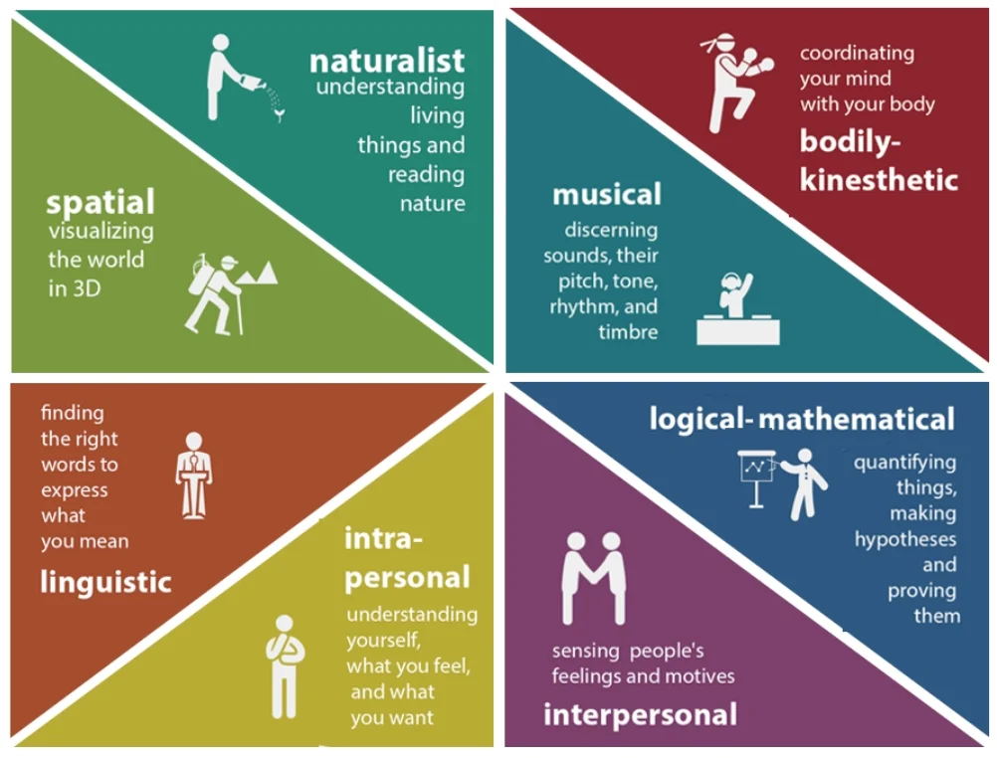
GARDNER’S Theory of MULTIPLE INTELLIGENCES
Howard Gardner’s Theory of Multiple Intelligences suggests that individuals possess various distinct types of intelligences, rather than a single general intelligence.
Gardner argues that we have a minimum eight different forms of intelligence, each relatively independent of the others: musical, bodily kinesthetic, logical mathematical, linguistic, spatial, interpersonal, intrapersonal, and naturalist.
Gardner theorizes that people do not have just an intellectual capacity, but have many kinds of intelligence

Slide 9
FLUID AND CRYSTALLIZED INTELLIGENCE
Some psychologists suggest that there are two different kinds of intelligence: fluid intelligence and crystallized intelligence.
Fluid intelligence reflects information-processing capabilities, reasoning, and memory. Fluid intelligence encompasses the ability to reason abstractly.
Example:
If we were asked to solve an analogy, group a series of letters according to some criterion, or remember a set of numbers, we would be using fluid intelligence.
We use fluid intelligence when we’re trying to rapidly solve a puzzle

Slide 10
Crystallized intelligence is the accumulation of information, skills, and strategies that people have learned through experience and that they can apply in problem-solving situations. It reflects our ability to call up information from long-term memory.
Example:
We would be likely to rely on crystallized intelligence, for instance, if we were asked to participate in a discussion about the solution to the causes of poverty, a task that allows us to draw on our own past experiences and knowledge of the world.

Slide 11
What is IQ???

Slide 12
Think
Earlier this year, 11-year-old Kashmea Wahi of London, England scored 162 on an IQ test. That’s a perfect score. The results were published by Mensa, a group for highly intelligent people. Wahi is the youngest person ever to get a perfect score on that particular test.
Does her high score mean she will go on to do great things — like Stephen Hawking or Albert Einstein, two of the world’s greatest scientists? Maybe. But maybe not.

Slide 13
IQ, short for intelligence quotient, is a measure of a person’s reasoning ability.
In short, it is supposed to device how well someone can use information and logic to answer questions or make predictions.
IQ tests begin to assess this by measuring short- and long-term memory. They also measure how well people can solve puzzles and recall information they’ve heard — and how quickly.

Slide 14
Every student can learn, no matter how intelligent. But some students struggle in school because of a weakness in one specific area of intelligence.
These students often benefit from special education programs.
There, they get extra help in the areas where they’re struggling. IQ tests can help teachers figure out which students would benefit from such extra help.
IQ tests also can help identify students who would do well in fast-paced “gifted education” programs.
Many colleges and universities also use exams similar to IQ tests to select students. And the U.S. government — including its military — uses IQ tests when choosing who to hire. These tests help predict which people would make good leaders, or be better at certain specific skills.

Slide 15
It’s tempting to read a lot into someone’s IQ score.
Most non-experts think intelligence is the reason successful people do so well.
Psychologists who study intelligence find this is partly true.
IQ tests can predict how well people will do in particular situations, such as thinking abstractly in science, engineering or art. Or leading teams of people. But there’s more to the story. Extraordinary achievement depends on many things.
“Intelligence matters. But not as much as you might think.”

Slide 16
What is EQ then????

Slide 17
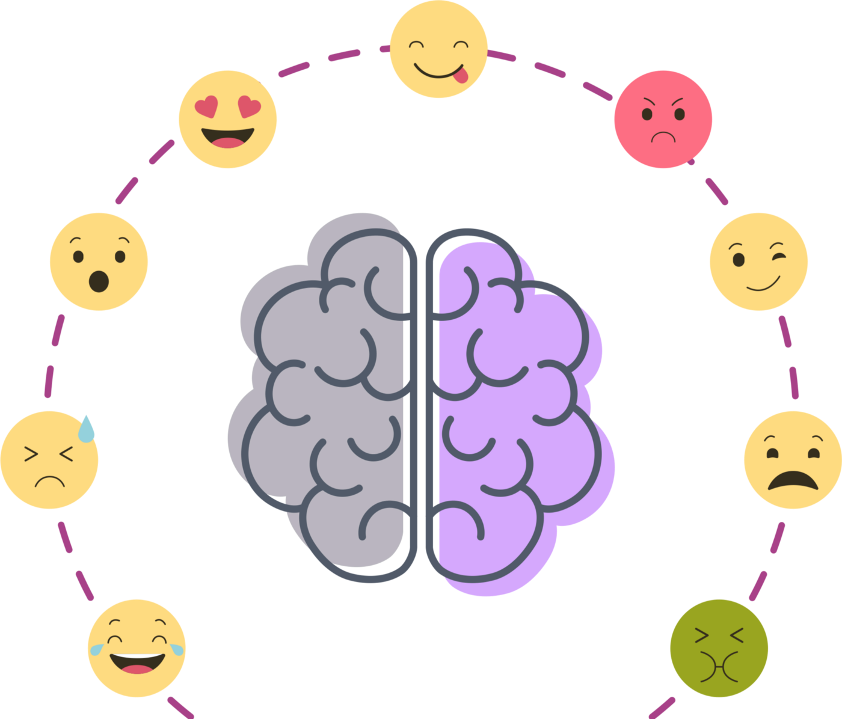
What we mean by emotions?
Subjective (personal) experience that arises unconsciously and spontaneously in response to the environment around us. It is an automated response to events that happens to us. (emotion is how the body responds)
A complex state of feeling that results in physical and psychological changes that influence thought and behavior.

Slide 18
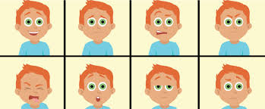
Emotions have three components:
Subjective component: How you experience the emotion (conscious experience)
For example, one person may feel anger and regret at the loss of a loved one while another may experience intense sadness.
Physiological component: How your body reacts to the emotion (rapid heartbeat etc.)
Expressive component: How you behave in response to the emotion (physical reaction)
For example: smile, a grimace, a laugh or a sigh, along with many other reactions depending on societal norms and personality.

Slide 19
Here are a few facts about emotions: Emotions come and go. Most of us feel many different emotions throughout the day. Some last just a few seconds. Others might linger to become a mood. Emotions can be mild, intense, or anywhere in between. The intensity of an emotion can depend on the situation and on the person. There are no good or bad emotions, but there are good and bad ways of expressing (or acting on) emotions. Learning how to express emotions in acceptable ways is a separate skill — managing emotions — that is built on a foundation of being able to understand emotions.

Slide 20
A study in the Journal of Abnormal Psychology found that while watching negative and positive emotional films, suppression of behavioral responses to emotion had physical effects on the participants.
The effects included elevated heart rates.
This suggests that expressing behavioral responses to stimuli, both positive and negative, is better for your overall health than holding those responses inside.
Thus, there are benefits of smiling, laughing and expressing negative emotions in a healthy way.

Slide 21
Why emotions are important?
It helps us build better relationships.
Emotions Help You Avoid Danger
Emotions Help Others Understand You Better
Emotions Allow You to Understand Others

Slide 22
IMAGINE A LIFE WITHOUT EMOTIONS?
Discussion
It would be impossible to develop bonds with people.
We cannot be safe since we couldn’t care less if danger meets our door.
Also, losing that unconscious function of emotions makes us lose our fight or flight reactions.
TED BUNDY CASE (ANTISOCIAL PERSONALITY)

Slide 23
Emotion Triggered by Behavioral response
Anger Being prevented from Destroy the thing
doing something you in your way, yelling, arguing, cursing and sarcasm.
you feel has deliberately
done you wrong
Fear Any threat or danger Protection often through
‘freezing’ so you are
not noticed , avoidance
Sadness Loss of something Search for help
important and comfort/Crying
Disgust Something gruesome, Reject or push away the
awful thing that is revolting
Surprise A sudden unexpected Focus on the new thing,
event wide eyes take in as
much as possible

Slide 24
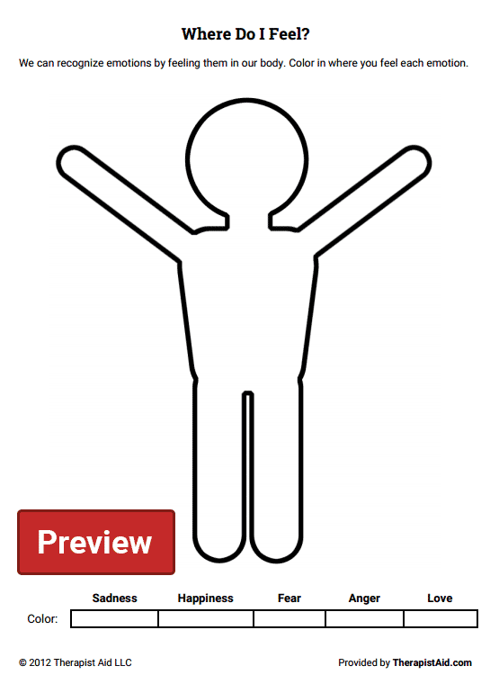
ACTIVITY

Slide 25
What is emotional intelligence?
Emotional intelligence or EI is the ability to understand and manage your own emotions, and those of the people around you. People with a high degree of emotional intelligence know what they're feeling, what their emotions mean, and how these emotions can affect other people.

Slide 26
Emotional intelligence helps us to: identify, use, understand,and manage emotions in positive ways to relieve stress, communicate effectively, empathize with others, overcome challenges, and defuse conflict.
Notes:
https://careers.gazprom-mt.com/blog/how-to-develop-emotional-intelligence/
https://www.slideshare.net/rksen/presentation-on-emotional-intelligence

Slide 27
EQ >IQ Emotional Quotient is greater than Intelligence Quotient

Slide 28
Overall impact on success.
It has been said that your IQ can land you a job but your lack of EQ can get you fired.
Your IQ only accounts for 20% of your success in life.
Your emotional intelligence and social intelligence are much greater determinants of the success you will achieve in life
It is not the strongest of the species that survives, nor the most intelligent, but the one most responsive to change." - Charles Darwin

Slide 29
FOUR COMPONENTS OF EMOTIONAL INTELLIGENCE.

Slide 30
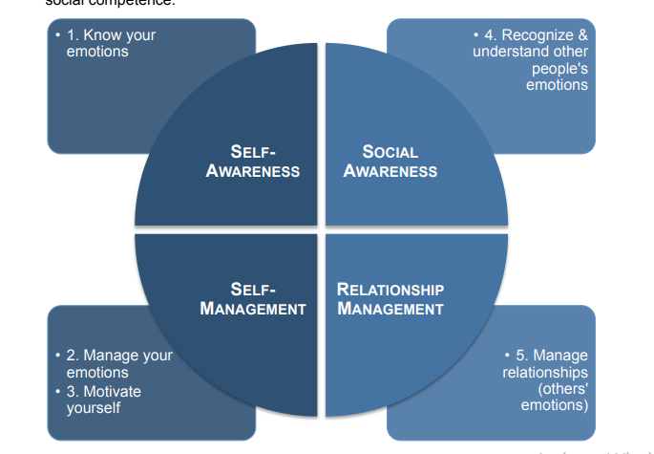

Slide 31
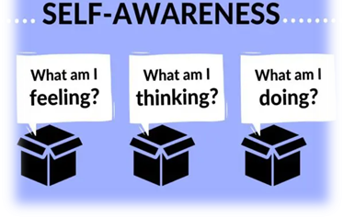

Slide 32
1. Self awareness:
Self-awareness involves being aware of different aspects of the self including traits, behaviors, and feelings
Knowing your strengths ,Weaknesses
or the ability to recognize and understand your own emotions, is a critical emotional intelligence skill.
being aware of the effect of your actions, moods, and emotions on other people
Being aware of your own feelings puts you in charge, not your emotions.

Slide 33

How to improve self-awareness:
Keep a journal
Meditate
Pay attention to your thoughts and emotions
Reflect on your experiences

Slide 34
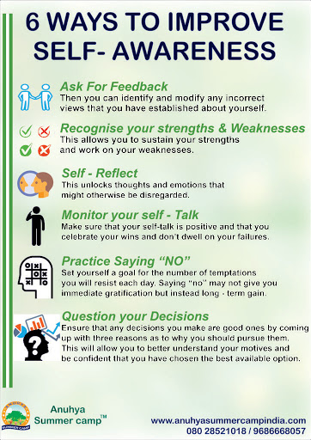


Slide 35
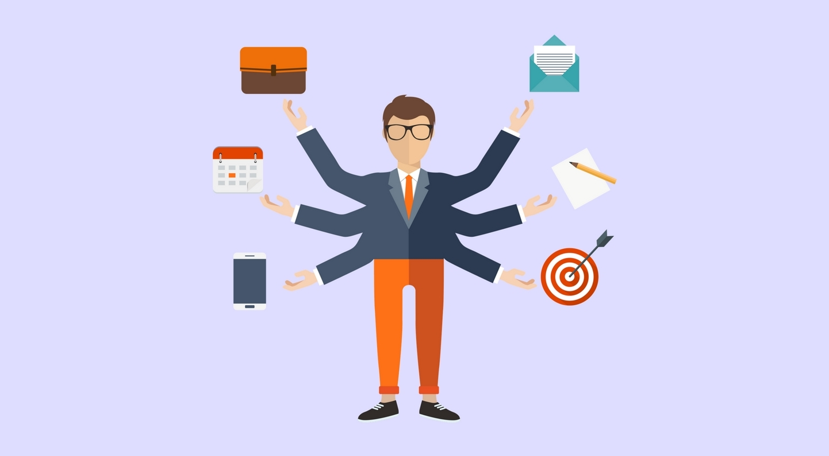
2. SELF MANAGEMENT:
Self management is also called self regulation which is all about expressing your emotions appropriately

Slide 36
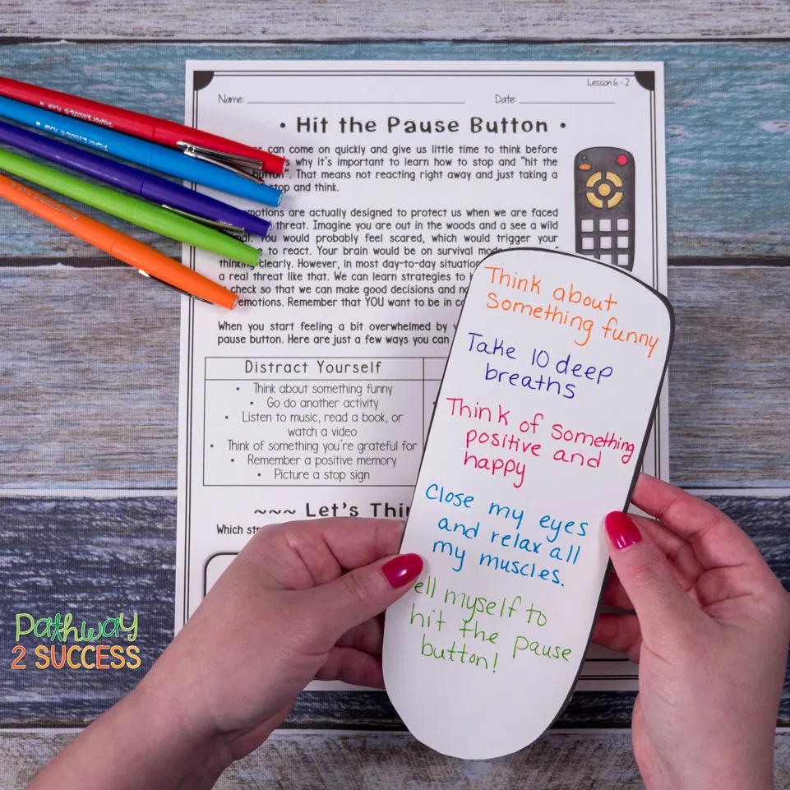
How to Improve Self-Regulation/Self management?
Recognize that you have a choice in how you respond.
Work on accepting your emotions.

Slide 37
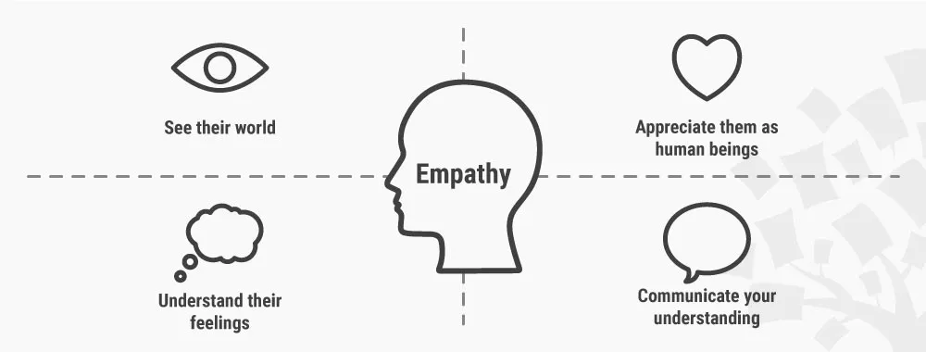
3.Social Awareness /Empathy
Empathy, or the ability to understand how others are feeling, is absolutely critical to emotional intelligence

Slide 38
How to build empathy/social awareness?
Try to imagine yourself in someone else's place.
Be willing to share your own feelings.
Engage in a cause such as a community project.
Listen to other people.

Slide 39
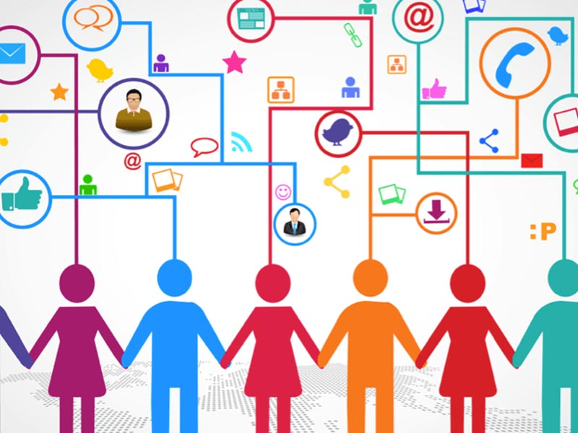
4. Social skills /Relationship Management:
Being able to interact well with others is another important aspect of emotional intelligence.

Slide 40
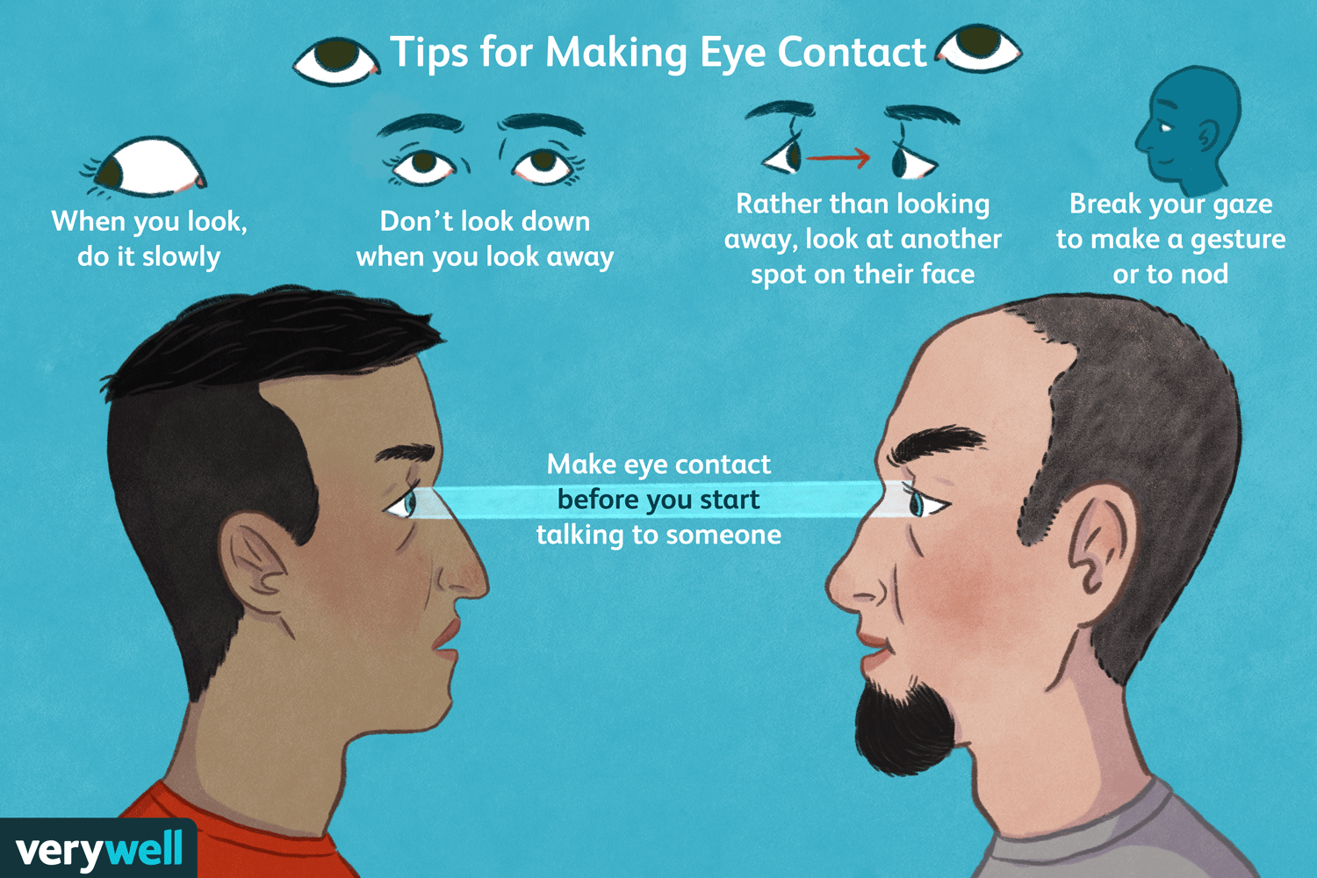
HOW TO IMPROVE SOCIAL SKILLS?
Practice good eye contact.
Notice other people's social skills.
Show interest in others.

Slide 41
Why Emotional Intelligence Skills Are Important
Emotional intelligence allows you to be a more effective leader.
Understanding how others are feeling allows you to communicate with them better.
Knowing more about what you are feeling allows you to be more self-aware and understand yourself more deeply.
By being more aware of your emotions, you can also improve your self-control abilities.
Managing your emotions effectively allows you to exert greater control in situations marked by stress or conflict.

Slide 42
THANKYOU!!!

